Slide 1
Ten Years Teaching Graduate Students Online
Some Hard Lessons
Tom Worthington, Honorary Lecturer,
ANU Research School of Computer Science
Notes:
Summary
The online graduate course "ICT Sustainability" was first run in 2009 and has been offered each year since by ANU, two other institutions in Australia and in North America. Course designer Tom Worthington discusses how the needs of global industry and academia were incorporated and the changes made in the ten years this award winning course has been running. Tom discusses how to keep students working online and keep study relevant to the workplace. Adapting the course for industry, open universities and as a free open online module are covered.
For Edtechposium 2018, 29 October 2018, Canberra (demonstration) and ANU TELFest, 11am, 5 November 2018 in Canberra (presentation).

Slide 2
The Course
“Green Computing” for postgraduate computing students.
12 weeks using Moodle.
First offered by ACS & ANU in 2009.
Now by ANU & Athabasca U.
Creative Commons licensed.
Notes:
The Australian Computer Society identified a need for training of computer professionals in environmental issues in 2008. Tom Worthington was commissioned to design a 12 week online course on what was then called “Green Computing” (Worthington, 2012). This was intended to be delivered as part of an industry graduate certificate for computer professionals. The course was designed for the Moodle learning management system and released under a Creative Commons license. The first cohort of students started the course in early 2009. At this time the Australian National University had transitioned to the Moodle system and the porting of the course from ACS to ANU was found to be relatively simple. The first cohort of ANU students commenced in second semester 2009.
Two cohorts of students (ACS and ANU) progressed through the course a few weeks apart with the same tutor, who was also the course designer. While the course content was identical for the two cohorts, there were subtle differences in assessment for the vocational and university cohorts. Later one of the graduates of the ANU course adapted the material for Athabasca University Canada, creating a third version (Stewart, ?). Athabasca staff later created self paced MOOC-like version of the course, resulting in four known versions (the course materials are open access, so more may exist). All known versions are listed in the introduction to the published course notes for the ANU course, along with details of revisions (Worthington, 2017b).

Slide 3
Addressing Global Requirements
Sustainability:
“Provides expert advice and guidance on planning, designing and implementing sustainability solutions. Evaluates and selects sustainability methods, tools and practices to be used in line with agreed policies and standards. Identifies and recommends improvements to the organisation's approach to sustainability.”
Skill “SUST” Level 5, from “Skills Framework for the Information Age” (SFIA), Version 7, 2018.
Notes:
The course was designed for the needs of the global computer industry and international qualifications standards. Course content and assessment is aligned with the Skills Framework for the Information Age (SFIA Foundation, 2009). The course is also designed for the requirements of the international accreditation of computer professional qualifications under the Soul Accord (2011).

Slide 4
Evolving Teaching and Assessment Techniques
Moodle eBook, readings and optional videos: No recorded lectures.
Weekly discussion questions: peer assessed in Moodle forum module.
Automated weekly quizzes from Athabasca U. adopted for ANU.
Now: 20% for weekly forum, 10% quizzes, 70% assignments (10% plan, 60% do).
Notes:
The course was designed for online delivery, not having been adapted from a face-to-face course. A set of text based notes are provided to students electronically (also published as a book), along with readings and optional videos. Unlike many online courses there are no recorded lectures, instead students are guided through the text with weekly discussion questions. Students were initially given a weekly grade by the tutor based on their answering and discussion in a text based forum. This was later changed to peer assessment using Moodle's forum module. Athabasca's self paced version of the course introduced weekly automated quizzes and these were adopted for ANU using Moodle's quiz module. The latest version of the course assessment has 20% for weekly forum contributions (2% per week, best 10 of 12 weeks, by peer assessment), 10% automated quizzes (10 x 1% each) and two assignments of 35% each (each in two parts: 5% plan, 30% do).

Slide 5
Some of the hard lessons
Online Teaching is a Skill to Learn
Videos Are Not Necessary for Online Courses
Peer Assessment Works
Marks Are Needed to Keep Online Students Working
A little feedback goes a long way
Provide Accessible Notes to Student's Phones
Notes:
1. Online Teaching is a Skill to Learn: The initial course design was adapted from an existing ACS online course by a university lecturer with no formal training in course design and no experience as an online student. Subsequent formal training in course design and particularly experience of being an online student, made the process much easier (Worthington, 2017a).
2. Videos Are Not Necessary for Online Courses: The course was developed using traditional distance education techniques, with text based notes, text based asynchronous communication between students and with staff. This has proved robust and successful. Students undertaking the online course achieve similar results to those for their conventional lecture based on-campus courses.
3. Peer Assessment Works: Peer assessment of students produced similar results to tutor assessment. Students accepted this form of assessment, provided it was made clear a tutor was checking the process.
4. Marks Are Needed to Keep Online Students Working: The course assessment scheme has marks awarded every week for discussion and a quiz. This was found necessary to keep students studying. Without the routine of a face-to-face class to attend it is too easy for students to neglect their online studies. The assessment scheme has been adjusted several time to attempt to find the correct balance between small rewards for weekly work, and large assessment items for evaluating deeper knowledge. The current scheme limits the grade a student can achieve from the weekly work to a “Credit”.
5. A little feedback goes a long way: Students are provided with weekly feedback. This consists of their mark for the week and one or two sentences. This has been found to be effective, as students look out for the mark. The weekly marks have also been found to be a good indicator of student progress. Students at risk can be identified from their low marks in the first few weeks of the course.
6. Provide Accessible Notes to Student's Phones: Learning Management Systems, such as Moodle, are now capable of providing most of their functions to a student via a mobile phone. However, the course content has to be suitably formatted. Much time and trouble can be saved by formatting the course materials as accessible HTML documents, which will scale to fit on the student's phone or laptop. There is then no need for a special mobile version of the software or course materials. As the course materials are in a standard web format they can also be easily ported to other software, and produced as an eBook or printed book

Slide 6
Demonstration
Global skills definitions translated to Learning Outcomes and Assessment Tasks.
Text based course eBook also published book.
Responsive design and reflowing content for Mobile devices.
Automated quizzes.
Peer assessed forums.

Slide 7
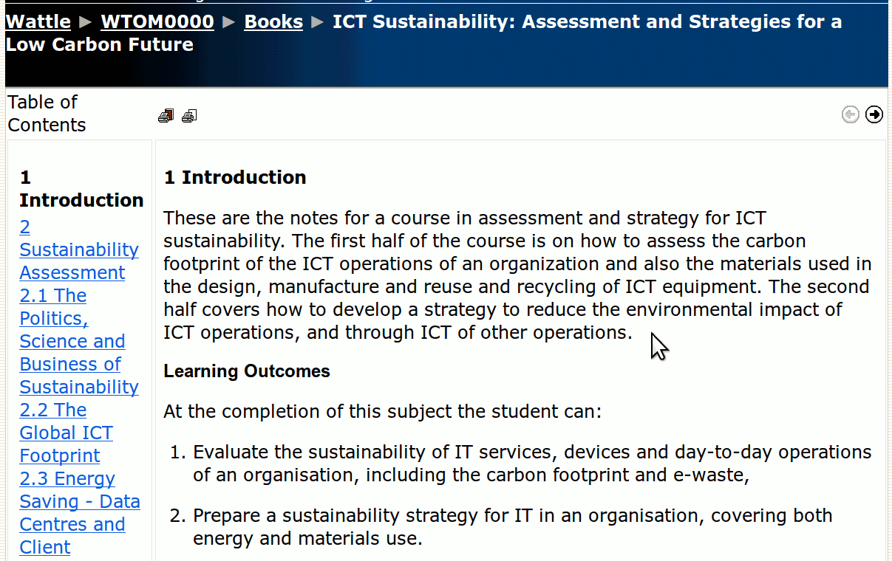
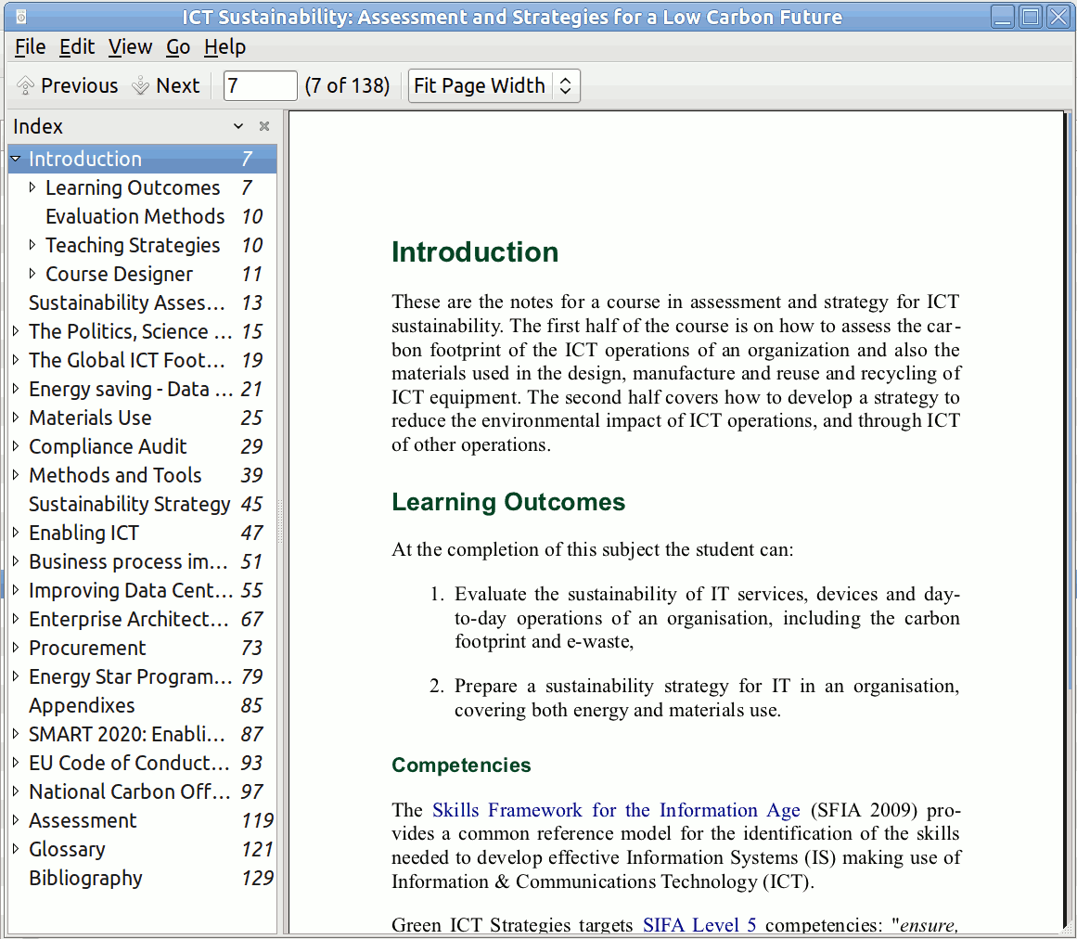
Course eBook and Published Book

Slide 8
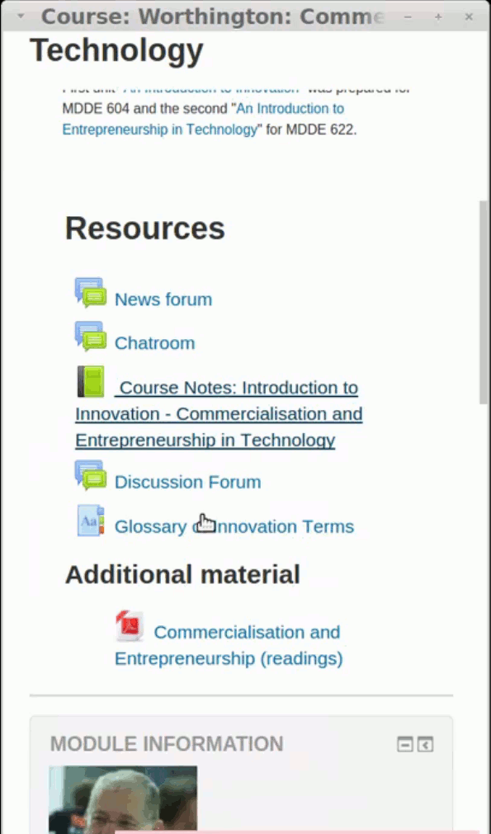
Responsive & reflowing for mLearning

Slide 9
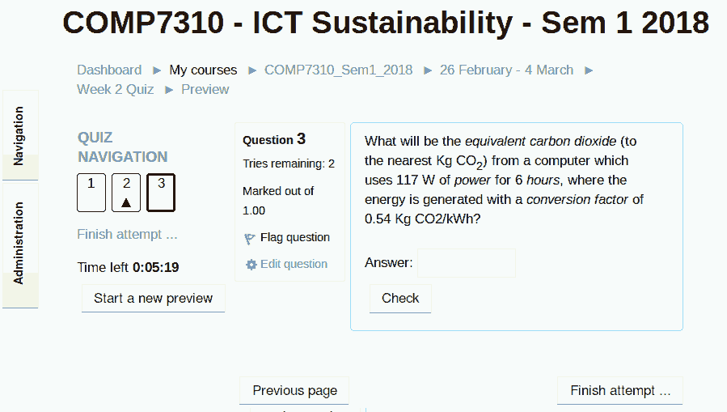
Automated quizzes

Slide 10
Peer assessed forums

Slide 11
References
Seoul Accord Secretariat, (2011). Seoul Accord. URL: http://www.seoulaccord.org/
SFIA Foundation. (2009). Skills Framework for the Information Age. URL: http://www.sfia.org.uk/
Stewart, B (?). Green ICT Strategies, COMP 635, Athabasca University, Canada. URL: http://www.athabascau.ca/syllabi/comp/comp635.php
Worthington, T. (2012, July). A Green computing professional education course online: Designing and delivering a course in ICT sustainability using Internet and eBooks. In Computer Science & Education (ICCSE), 2012 7th International Conference on (pp. 263-266). IEEE. URL: https://doi.org/10.1109/ICCSE.2012.6295070
Worthington, T. (2017a). Digital Teaching In Higher Education: Designing E-learning for International Students of Technology, Innovation and the Environment. URL: http://www.tomw.net.au/digital_teaching/introduction.shtml#user_goals
Worthington, T. (2017b). ICT Sustainability: Assessment and Strategies for a Low Carbon Future. URL: http://www.tomw.net.au/ict_sustainability/introduction.shtml

