Slide 1
Teaching Green Computing Online: 15 Years of Student Engagement via Nudging
Tom Worthington
School of Computing Australian National University, Canberra, Australia
April 2024
Notes:
Teaching Green Computing Online: 15 Years of Student Engagement via Nudging, by Tom Worthington, School of Computing, the Australian National University, April 2024.
For HERDSA Special Interest Group Online Engagement in Higher Education, Wednesday 10th April 2024, 1:00 pm AEST (free online).
Event description
In 2008 the Australian Computer Society commissioned Tom Worthington to design an online course in green computing. This course formed part of the Australian Computer Society’s professional development program. This was later run at the Australian National University as a masters course, and is still offered fifteen years later through Athabasca University (Canada).
The course uses a conventional text-based distance education format, with no video, and no webinars. Why? What was the rationale? This presentation shares key design principles of this unique format that has positively impacted student engagement. As a means of facilitating student engagement nudging techniques have been employed.
This HERDSA Special Interest Group, Online Engagement in Higher Education, will discuss the factors that have improved online student engagement and consider implications and applications of their own online courses, including a coordinated nudging process. This event will provide insights for those looking to adopt a nudging approach to better facilitate student engagement and learning.
Join this to see how this works, and can be applied at your institution.

Slide 2
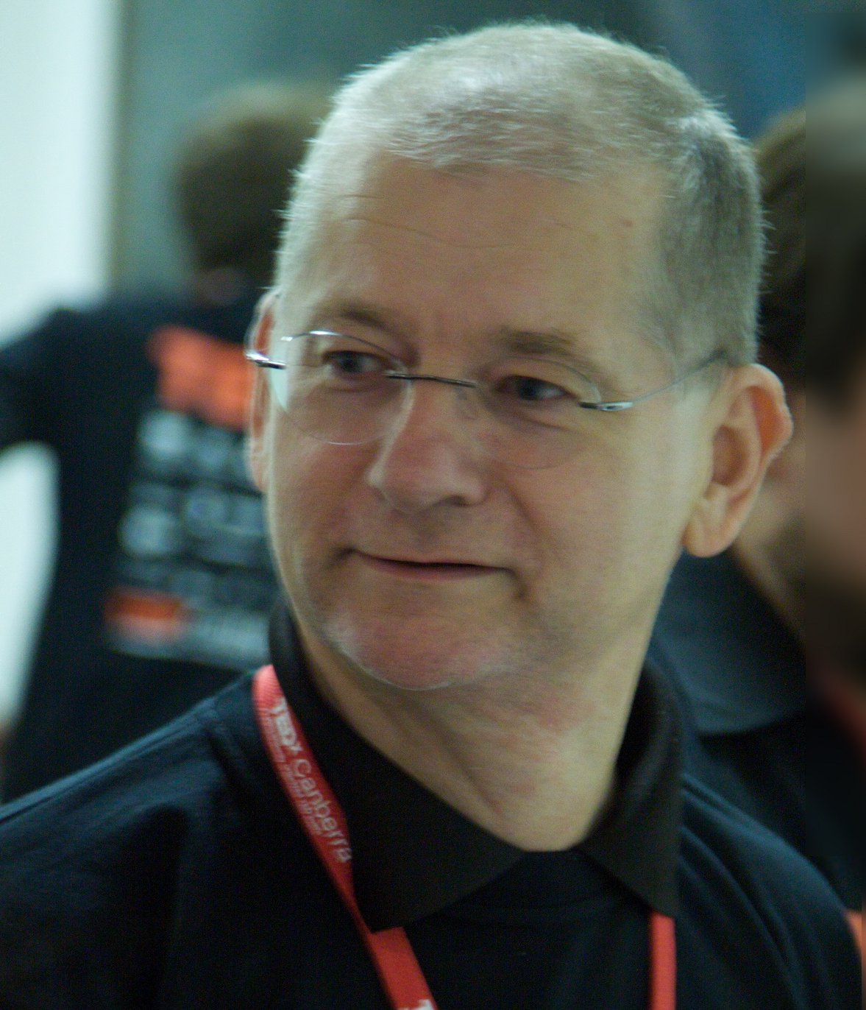
Tom Worthington
Honorary Lecturer, Computer Science ANU
Professional Education Governance committee member, Past President, Honorary Life Member & Fellow of the Australian Computer Society
Fellow of Advance HE (UK)
Life member IEEE
Blogs as the Higher Education Whisperer
Notes:
About the Speaker: Tom Worthington is an independent computer professional, educational designer and an Honorary Senior Lecturer in the School of Computing at the Australian National University.
A Certified Professional member of the Australian Computer Society, in 2015 Tom received a national gold Digital Disruptors Award for "ICT Education" and in 2010 was Canberra ICT Educator of the Year. Tom previously worked on IT policy for the Australian Government, and in 1999 he was elected a Fellow of the Australian Computer Society for his contribution to the development of public Internet policy. He is a Past President, Honorary Life Member, Certified Professional and a Certified Computer Professional of the society as well as a life member of the Institute of Electrical and Electronics Engineers, and Fellow of Advance HE (UK).
Tom has a Masters in Education (specializing in Distance Education) from Athabasca University, a Graduate Certificate in Higher Education from the Australian National University and a Certificate IV in Training and Assessment from the Canberra Institute of Technology. He blogs as the HigherEducationWhisperer.com.
While an Honorary Lecturer in Computer Science at the Australian National University, and the Professional Education Governance Committee of the Australian Computer Society, his views here do not necessarily reflect those of either organization.

Slide 3
Learning to Combat Global Warming
Desktop computer clipart, CC 0 AJ from openclipart.org
Factory by Howard Cheng, Public domain, via Wikimedia Commons
Sun by David Vignoni, GNU Lesser General Public License
Computers > electricity > fossil fuel > CO2 > global warming.
HMAS Perth with a Phased Array Radar from CEA Technologies in Canberra Source: https://www.flickr.com/photos/133059881@N02/19756029272
HMAS Perth with a Phased Array Radar from CEA Technologies in Canberra Source: https://www.flickr.com/photos/133059881@N02/19756029272
Notes:
Computers and telecommunications (ICT) equipment are powered by electricity. If the electricity is generated by burning fossil fuel, this releases carbon dioxide (CO2) into the atmosphere. The CO2 is a greenhouse gas, which traps sunlight, causing global warming.
A carbon emissions audit for the the Australian Computer Society (ACS), reported in 2007 that 1.52% of Australian carbon emissions were attributable to computers and telecommunications equipment.
Reference
Audit of Carbon Emissions resulting from ICT usage by Australia Business, by Shadi Haddad, Ethan Group Pty Limited. For the Australian Computer Society, August 2007 https://web.archive.org/web/20070907015722/http://www.acs.org.au/acs_policies/docs/2007/greenictaudit.pdf

Slide 4
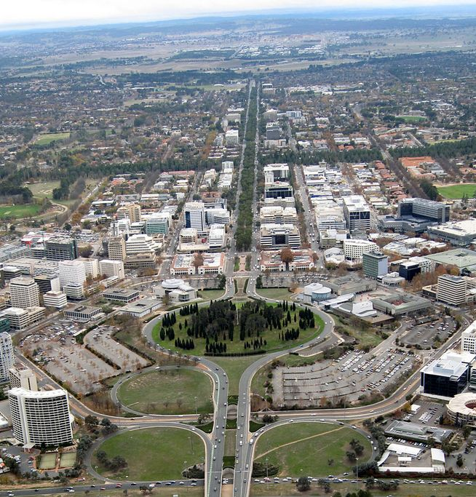
Green Computing Course
How to measure and reduce ICT’s CO2
Commissioned in 2008 by ACS
Designed by Tom Worthington
First run February 2009 by ACS & through OUA
For ANU masters students from July 2009
For Athabasca University (Canada) from 2011 and still running.
Course available free under a CC licence.
Wade Johanson from Canberra, Australia, CC BY 2.0 via Wikimedia Commons
Notes:
The Australian Computer Society (ACS) commissioned a course in 2008 on how to measure and reduce ICT CO2. This was part of a graduate certificate offered by the ACS to working computer professionals. Some universities offered credit in masters programs to those undertaking the program’s courses, and it was offered through Open Universities Australia.
The course was developed by Tom Worthington and first run by ACS in February 2009 as “Green ICT Strategies”. He then adapted it for the computing graduate program at Australian National University (ANU), where it ran from July 2009 as “Green Information Technology Strategies” (COMP7310). It was then adapted by one of the ANU students as “Green ICT Strategies” for Athabasca University (Canada) in 2011, where it is still offered today.
The course notes are available free for use, under a Creative Commons licence:
ICT Sustainability: Assessment and Strategies for a Low Carbon Future, Tom Worthington, 2018 https://www.tomw.net.au/ict_sustainability/
As described in: Worthington, T., "A Green computing professional education course online: Designing and delivering a course in ICT sustainability using Internet and eBooks," Computer Science & Education (ICCSE), 2012 7th International Conference on , vol., no., pp.263,266, 14-17 July 2012 URL: http://dx.doi.org/10.1109/ICCSE.2012.6295070

Slide 5
Format
Traditional distance education online course.
12 weeks,
One topic per week,
One small assessment per week,
Two large assignments.
Symbol for pollutants, from directive 67/548/EWG of European Chemicals Bureau.

Slide 6
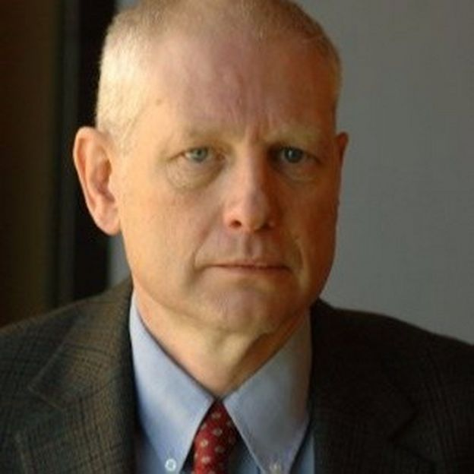
Delivered as Text
Moodle eBook.
One chapter per week.
One exercise at the end of each chapter.
Default HTML used, allowing for transfer of content from ACS to ANU to Athabasca.
Brian Stewart, Chief Information Officer, Simon Fraser University. Adapted the course when at Athabasca.
Notes:
The course notes are provided as a Moodle eBook, delivered using the Moodle Learning Management System (MLS). Each week’s work is one chapter of the book, ending with a small assessed student exercise. Moodle uses HTML, and the content uses default formatting. This allowed the course to be exported from the ACS Moodle instance to ANU and from ANU to Athabasca University with each taking on the style imposed by that institution. It also allowed Kindle, PDF, and paper published versions to be produced. The use of default web text allows students using mobile phones, and those on slow Internet connections to have access. It also allows for text to speech, and other accessibility devices to be used.
Footnote: The photo shows Brian Stewart, currently Chief Information Officer at Simon Fraser University. Brian undertook the green computing course at ANU, then adapted it for Canada, at Athabasca University, when CIO there.

Slide 7
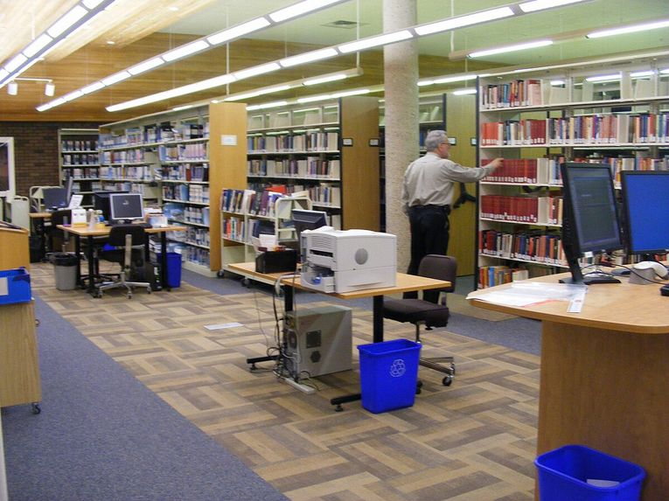
Assessment: Where the magic happens
Weekly forum contribution: 20%
Questions and answers to the online forum
Mark and feedback each week from the tutor
Written assignments: mid and end: 80%.
Athabasca University Library, Mags55, CC BY-SA 3.0
Notes:
Assessment is by contribution to weekly forums and two written assignments ) mid and end of course). The weekly forum questions are at the end of each week in the course book.
The key to having such a course format work is tying assessment to the weekly study. The student is prompted what to study each week, and the question for the week posted to a course forum. Students post their answers in that thread of discussion.
The students are reminded each week that the weekly answers can be used in their next assignment, and how many weeks to it being due. Each week students receive a grade, and group feedback (with individual feedback where necessary).
The grading scheme was designed so a student can miss two week’s work without penalty. But students who do not submit for longer, or receive zero for some other reason, would normally be referred to the program supervisor.
This approach requires considerable work from a tutor to grade work. In later courses I have used the Moodle Workshop module to have students provide peer feedback, and a peer grade. It should also be possible to use AI. The marking scheme is designed so these small assignments do not contribute to a high mark. Footnote: The photo shows the Athabasca University Library in 2012, but looks as it could be from decades before. But it doesn’t matter what it looks like as few of the students, who are online, ever see it.

Slide 8
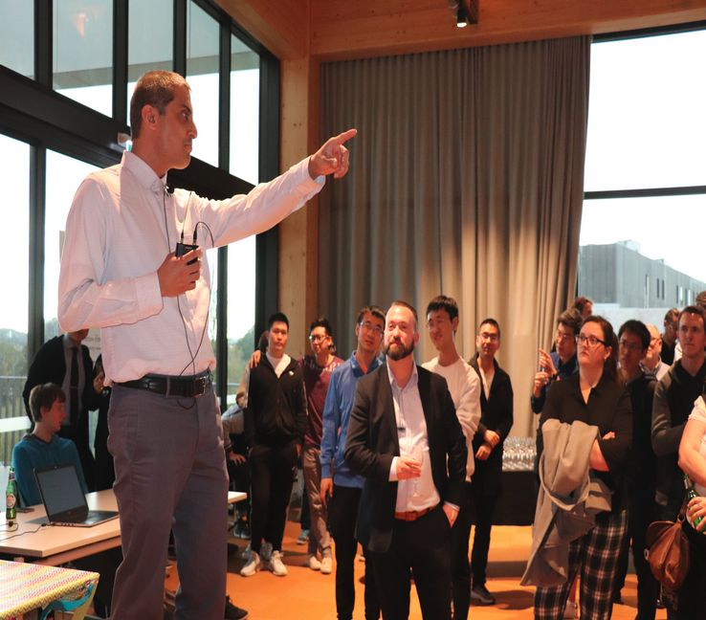
Students Pay Attention to Assessment
Students pay attention to feedback accompanied by marks.
2% is sufficient to nudge the students.
Tutors are provided with suggested posts to students, & boilerplate replies. The ANU Techlauncher program turbocharges feedback from students, tutors, & clients, with a bespoke system & ties it to grades grades.
ANU TechLauncher Showcase 2019.
Notes:
Students pay attention to marks, so feedback is always accompanied by a mark. A weekly mark of 2% accompanying the feedback is sufficient to have the students pay attention.
The green computing course has a relatively simple system for feedback, using Moodle’s tools. In the ANU Techlauncher program for computer project students, feedback is collected by a bespoke system from students, tutors, & clients, closely tied to grades. See:
Techlauncher Project Audits, ANU, 2024. https://comp.anu.edu.au/TechLauncher/current_students/evaluation/project_audits/
Awasthy, R., Flint, S., & Sankaranarayana, R. (2017, April). Lifting the constraints—closing the skills gap with authentic student projects. In 2017 IEEE Global Engineering Education Conference (EDUCON) (pp. 955-960). IEEE. https://doi.org/10.1109/EDUCON.2017.7942964

Slide 9
Questions & More Information
Cochrane, T. D., Narayan, V., Aiello, S., Alizadeh, M., Birt, J., Bone, E., Cowie, N., Cowling, M., Deneen, C., Goldacre, P., Sinfield, D., Stretton, T., & Worthington, T. (2022). Analysing mobile learning designs: A framework for transforming learning post-COVID. Australasian Journal of Educational Technology, 38(4), 1–21. https://doi.org/10.14742/ajet.7997
TechLauncher: https://cs.anu.edu.au/TechLauncher/current_students/
Learning to Reflect Module for TechLauncher, Blog posts 2018 to 2022, with drafts, & commentary: https://www.tomw.net.au/technology/education/learning_to_reflect/
Tom Worthington, ANU Research School of Computer Science: tom.worthington@anu.edu.au

Slide 10
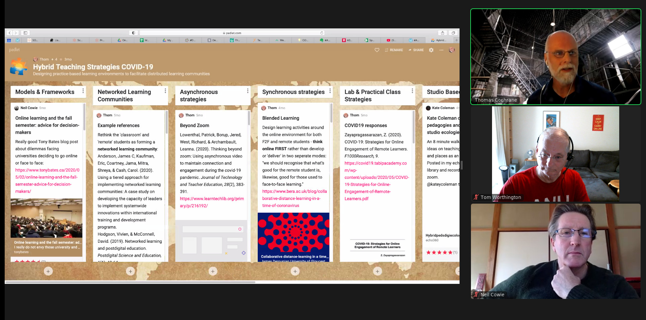
Over to You
Here are four questions to discuss:
1. What have you done to improve online student engagement?
2. What level of granularity is best for feedback to students: hourly, daily, weekly, monthly?
3. Do students get tired of boilerplate replies?
4. Will they get annoyed by AI generated feedback? Please type a reply to at least one using the tool provided, and comment on at least one other reply.
ASCILITE ML-SIG brainstorming a presentation using a real time tool (Padlet).

